Slide 1
John 13:18-38 Rod Thom
“LOVE ONE ANOTHER”

Slide 2
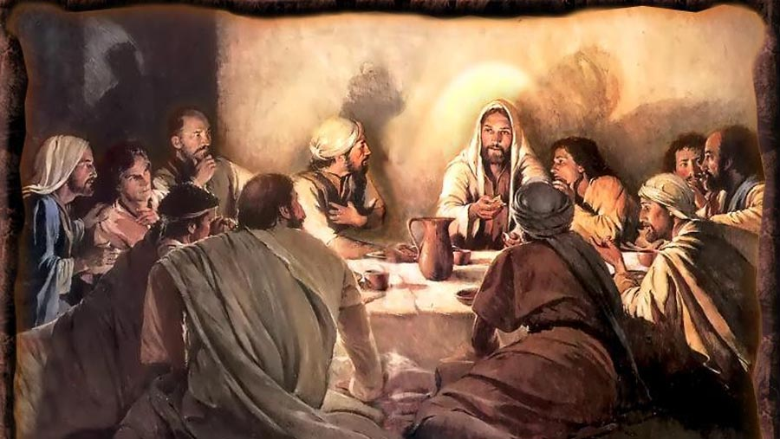
Love One Another

Slide 3
Love One Another
John 13:18-38 (NIV)
Jesus Predicts His Betrayal
18 “I am not referring to all of you; I know those I have chosen. But this is to fulfill this passage of Scripture: ‘He who shared my bread has turned against me.’
19 “I am telling you now before it happens, so that when it does happen you will believe that I am who I am. 20 Very truly I tell you, whoever accepts anyone I send accepts me; and whoever accepts me accepts the one who sent me.”

Slide 4
Love One Another
21 After he had said this, Jesus was troubled in spirit and testified, “Very truly I tell you, one of you is going to betray me.”
22 His disciples stared at one another, at a loss to know which of them he meant. 23 One of them, the disciple whom Jesus loved, was reclining next to him. 24 Simon Peter motioned to this disciple and said, “Ask him which one he means.”
25 Leaning back against Jesus, he asked him, “Lord, who is it?”

Slide 5
Love One Another
26 Jesus answered, “It is the one to whom I will give this piece of bread when I have dipped it in the dish.” Then, dipping the piece of bread, he gave it to Judas, the son of Simon Iscariot. 27 As soon as Judas took the bread, Satan entered into him.
So Jesus told him, “What you are about to do, do quickly.” 28 But no one at the meal understood why Jesus said this to him. 29 Since Judas had charge of the money, some thought Jesus was telling him to buy what was needed for the festival, or to give something to the poor. 30 As soon as Judas had taken the bread, he went out. And it was night.

Slide 6
Love One Another
Jesus Predicts Peter’s Denial
31 When he was gone, Jesus said, “Now the Son of Man is glorified and God is glorified in him. 32 If God is glorified in him,[c] God will glorify the Son in himself, and will glorify him at once.
33 “My children, I will be with you only a little longer. You will look for me, and just as I told the Jews, so I tell you now: Where I am going, you cannot come.

Slide 7
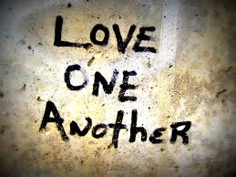
Love One Another
34 “A new command I give you: Love one another. As I have loved you, so you must love one another. 35 By this everyone will know that you are my disciples, if you love one another.”

Slide 8
Love One Another
36 Simon Peter asked him, “Lord, where are you going?”
Jesus replied, “Where I am going, you cannot follow now, but you will follow later.”
37 Peter asked, “Lord, why can’t I follow you now? I will lay down my life for you.”
38 Then Jesus answered, “Will you really lay down your life for me? Very truly I tell you, before the rooster crows, you will disown me three times!

Slide 9
Love One Another

Slide 10
Love One Another

Slide 11
Love One Another
34 “A new command I give you: Love one another. As I have loved you, so you must love one another. 35 By this everyone will know that you are my disciples, if you love one another.”

Slide 12
Love One Another
Leviticus 19:18 “‘Do not seek revenge or bear a grudge against anyone among your people, but love your neighbor as yourself. I am the Lord.

Slide 13
Love One Another
SO WHY does Jesus want us to play by a different set of rules?
He wants us to play by different set of rules because it will be the GLUE that holds us together and it will set us a part from the world
V35 By this everyone will know that you are my disciples, if you love one another.”

Slide 14
Love One Another
So how do we Love one another?
We need to CHOOSE LOVE
John 15:14 (Jesus speaking)
You are my friends if you do what I command.

Slide 15
Love One Another
So how do we play by this new set of rules, how do we Love one another?
2. We need to LOVE like Jesus
34 “A new command I give you: Love one another. As I have loved you,

Slide 16
Love One Another
So how do we Love one another?
We need to LOVE like Jesus
1 John 3:16-18 This is how we know what love is: Jesus Christ laid down his life for us. And we ought to lay down our lives for our brothers. If anyone has material possessions and sees his brother in need but has no pity on him, how can the love of God be in him? Dear children, let us not love with words or tongue but with actions and in truth.

Slide 17
Love One Another
So how do we Love one another?
We need to Love SACRIFICIALLY!
We need to Love by SERVING one another and the world.
We need to do everything in our power to preserve unity!

Slide 18
Love One Another
So how do we Love one another?
We need to move toward each other in love
We need to keep short accounts with each other
We need to ruthlessly eliminate gossip

Slide 19
Love One Another
So how do we Love one another?
We need to embrace and love those who are new/different in our community
We need to love those in our community who are hard to love

Slide 20
Love One Another

